Slide 1
Fall 2015 AI Game Project
Jayson Boubin and Tyler Moore

Slide 2
Overview
Opening book
Alpha-Beta Search
Transposition Table
Variable Depth Limit

Slide 3
Accolades
Beats systematic player
Beats random player
Has won over 10,000 games against random, systematic, and weaker versions of himself
Beats online “pro player” bot

Slide 4
Opening Book
Automatically Generates first two moves
Based off of:
Game theoretic investigation into Domineering openings
High depth limit alpha beta selection
Creates a random move in one of the four corners as shown

Slide 5
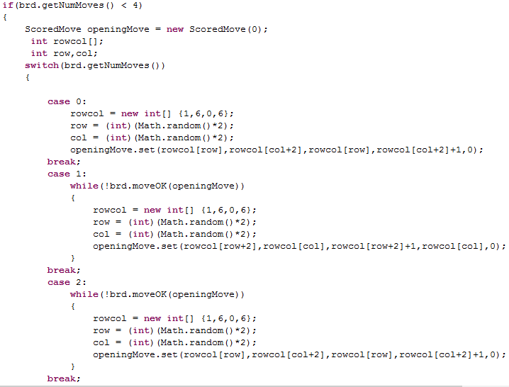
Opening Book

Slide 6
Transposition Table: Basic Overview
large hash table that stores hashed board positions (Keys) and the subsequent precalculated move associated (Values).
The board must be hashed using a hashing function
The Hash is used to create a key, at which a calculated move is stored.
Once the key is created, if the table doesn’t hold a value for that key, alpha beta is used to generate a move for that position.
If there is a value at the keys position, it must be validated and either used or replaced.

Slide 7
Transposition Table: Hashing
Hashing Function:
Reads each position on the board and assigns it either a 1 (filled) or 0 (unfilled).
Note: Who occupies the square does not matter
Generates a Long Integer based on each bit (0,0 is the first bit in the Long, 0,1 is the second etc...)
Mods the board position Long by 1 million to allow for a 1 million element hash table.

Slide 8
Transposition Table: Population and Replacement
Once a position has been hashed, if its position is unfilled:
Alpha Beta calculates the move associated with that position
The depth of the board (Number of moves) is recorded
A string is generated representing the move and board depth, and is added to the hash table
If the position is filled, the depth of the board is compared:
If the board depth of the move in the table is higher (more moves) it is replaced
If the board depth of the move is the same, the move is validated and used
if the board depth of the move is lower (less moves), the tables move is kept, and the current move is calculated by alpha beta.
This constitutes a largest tree replacement scheme

Slide 9
Transposition Table: Read/Write
While transposition tables are useful in long game scenarios, their benefit can be overshadowed by high initial calculation costs
Transposition table is read from a file at the beginning of every game
Once the game is over, the transposition table file is overwritten with the new table.
This allows our bot to remember previously calculated moves

Slide 10
Alpha-Beta Search
Begins at Depth Limit 8
Changes to Depth Limit 15 after 13 moves have been made
Random move ordering
Only used if transposition table and opening book fails

Slide 11
Evaluation Function
Evaluation searches for two different values,
Possible moves
Guaranteed moves
Possible moves: a position that can be occupied by a player
Adds 1 for white
subtracts one for black
Guaranteed Moves: a position that can only be occupied by one specific player
Adds 2 for white
Subtracts 2 for black

Slide 12
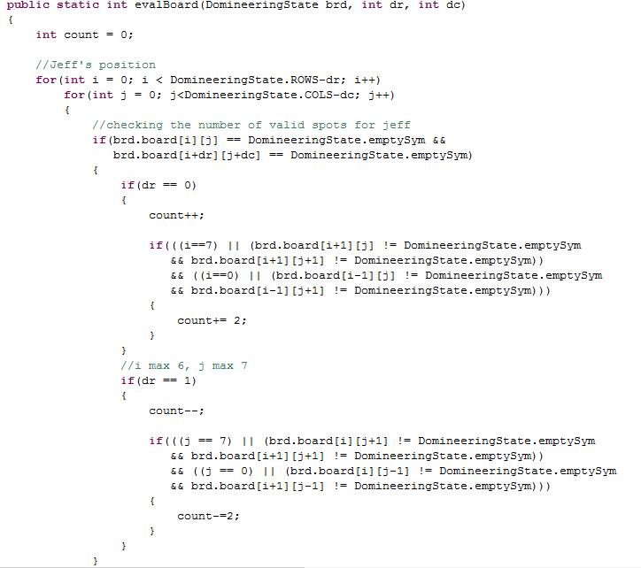
Evaluation Function

Slide 13
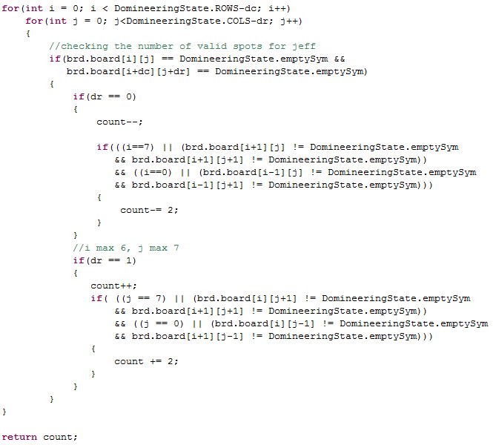
Evaluation Function Cont.

Slide 14
Demonstration:
Our bot will be playing against a “Pro” online bot.

Slide 15
Questions?

